Slide 1
Convolutional Neural Network

Slide 2
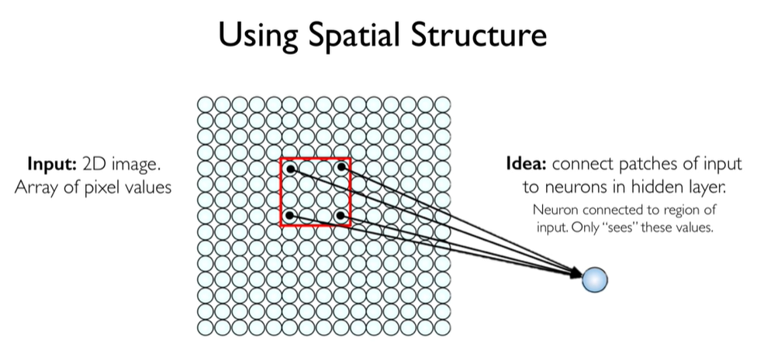

Slide 3
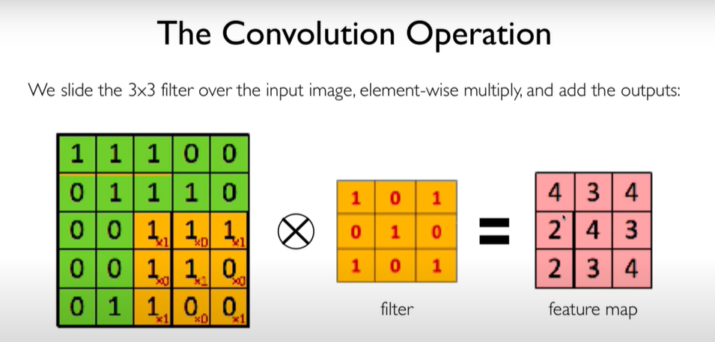

Slide 4
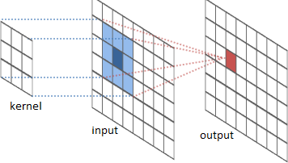
The convolution operation

Slide 5
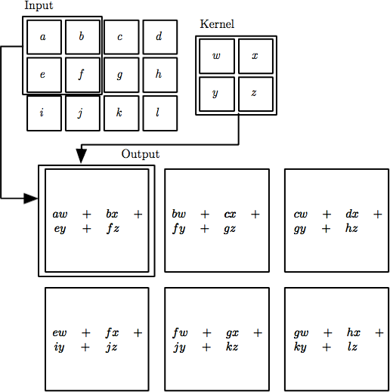

The convolution operation

Slide 6
Convolution
These are the network parameters to be learned.
1 | -1 | -1
-1 | 1 | -1
-1 | -1 | 1
1 | 0 | 0 | 0 | 0 | 1
0 | 1 | 0 | 0 | 1 | 0
0 | 0 | 1 | 1 | 0 | 0
1 | 0 | 0 | 0 | 1 | 0
0 | 1 | 0 | 0 | 1 | 0
0 | 0 | 1 | 0 | 1 | 0
Filter 1
-1 | 1 | -1
-1 | 1 | -1
-1 | 1 | -1
Filter 2
……
6 x 6 image
Each filter detects a small pattern (3 x 3).

Slide 7
Convolution Layer
32x32x3 image
32
height
32
depth
width
3

Slide 8
Convolution Layer
32x32x3 image
5x5x3 filter
32
Convolve the filter with the image
i.e. “slide over the image spatially, computing dot products”
32
3

Slide 9
Convolution Layer
Filters always extend the full
32x32x3 image
depth of the input volume
5x5x3 filter
32
Convolve the filter with the image
i.e. “slide over the image spatially, computing dot products”
32
3

Slide 10


Convolution Layer
32x32x3 image 5x5x3 filter
32
1 number:
the result of taking a dot product between the filter and a small 5x5x3 chunk of the image
(i.e. 5*5*3 = 75-dimensional dot product + bias)
32
3

Slide 11
Convolution Layer
activation map
32x32x3 image 5x5x3 filter
32
28
convolve (slide) over all spatial locations
32
28
3
1

Slide 12
Convolution Layer
32x32x3 image 5x5x3 filter
activation maps
32
28
convolve (slide) over all spatial locations
32
28
consider a second, green filter
3
1

Slide 13
For example, if we had 6 5x5 filters, we’ll get 6 separate activation maps:
activation maps
32
28
Convolution Layer
32
28
3
6
We stack these up to get a “new image” of size 28x28x6!

Slide 14
A closer look at spatial dimensions:
7
7x7 input (spatially) assume 3x3 filter
7

Slide 15
A closer look at spatial dimensions:
7
7x7 input (spatially) assume 3x3 filter
7

Slide 16
A closer look at spatial dimensions:
7
7x7 input (spatially) assume 3x3 filter
7

Slide 17
A closer look at spatial dimensions:
7
7x7 input (spatially) assume 3x3 filter
7

Slide 18
A closer look at spatial dimensions:
7
7x7 input (spatially) assume 3x3 filter
=> 5x5 output
7

Slide 19
A closer look at spatial dimensions:
7
7x7 input (spatially) assume 3x3 filter applied with stride 2
7

Slide 20
A closer look at spatial dimensions:
7
7x7 input (spatially) assume 3x3 filter applied with stride 2
7

Slide 21
A closer look at spatial dimensions:
7
7x7 input (spatially) assume 3x3 filter applied with stride 2
=> 3x3 output!
7

Slide 22
A closer look at spatial dimensions:
7
7x7 input (spatially) assume 3x3 filter applied with stride 3?
7

Slide 23
A closer look at spatial dimensions:
7
7x7 input (spatially) assume 3x3 filter applied with stride 3?
7
doesn’t fit!
cannot apply 3x3 filter on 7x7 input with stride 3.

Slide 24
N
Output size:
(N - F) / stride + 1
 |  |  | F
 | F
e.g. N = 7, F = 3:
stride 1 => (7 - 3)/1 + 1 = 5
stride 2 => (7 - 3)/2 + 1 = 3
stride 3 => (7 - 3)/3 + 1 = 2.33 :\
N

Slide 25
Zero-Padding

Slide 26
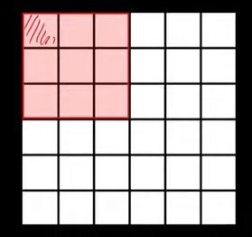

Slide 27
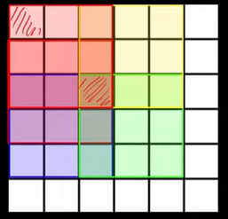

Slide 28
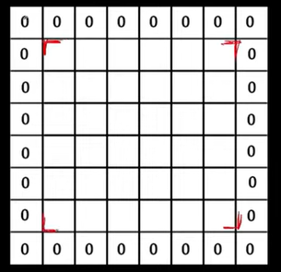

Slide 29
Zero-Padding: common to the border
0 | 0 | 0 | 0 | 0 | 0
0
0
0
0
e.g. input 7x7
3x3 filter, applied with stride 1
pad with 1 pixel border => what is the output?
(recall:)
(N - F) / stride + 1

Slide 30
Zero-Padding: common to the border
0 | 0 | 0 | 0 | 0 | 0
0
0
0
0
e.g. input 7x7
3x3 filter, applied with stride 1
pad with 1 pixel border => what is the output?
7x7 output!

Slide 31
Zero-Padding: common to the border
0 | 0 | 0 | 0 | 0 | 0
0
0
0
0
e.g. input 7x7
3x3 filter, applied with stride 1
pad with 1 pixel border => what is the output?
7x7 output!
in general, common to see CONV layers with stride 1, filters of size FxF, and zero-padding with (F-1)/2. (will preserve size spatially)
e.g. F = 3 => zero pad with 1 F = 5 => zero pad with 2 F = 7 => zero pad with 3
(N – F+2P) / stride + 1

Slide 32
Examples time:
Input volume: 32x32x3
10 5x5 filters with stride 1, pad 2
Output volume size: ?

Slide 33
Examples time:
Input volume: 32x32x3
10 5x5 filters with stride 1, pad 2
Output volume size:
(32+2*2-5)/1+1 = 32 spatially, so
32x32x10

Slide 34
Examples time:
Input volume: 32x32x3
10 5x5 filters with stride 1, pad 2
Number of parameters in this layer?

Slide 35
Examples time:
Input volume: 32x32x3
10 5x5 filters with stride 1, pad 2
Number of parameters in this layer? each filter has 5*5*3 + 1 = 76 params
=> 76*10 = 760
(+1 for bias)

Slide 36
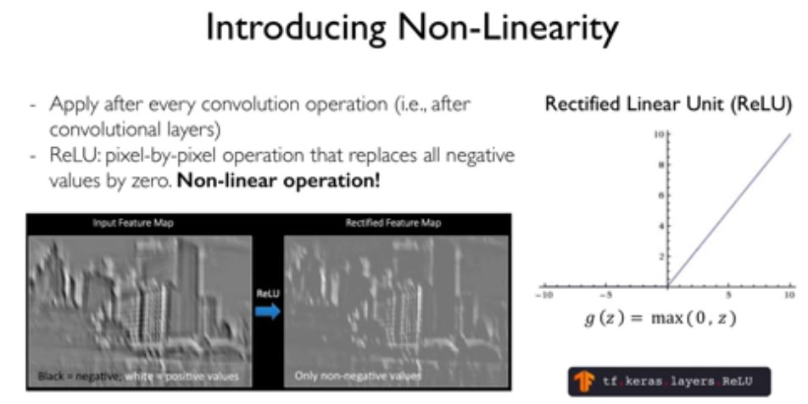
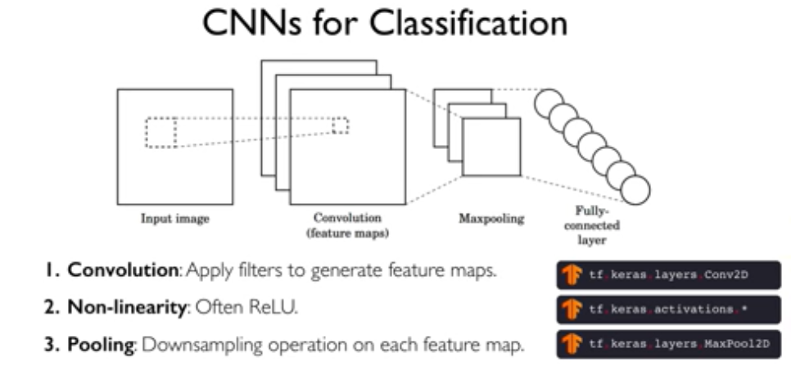
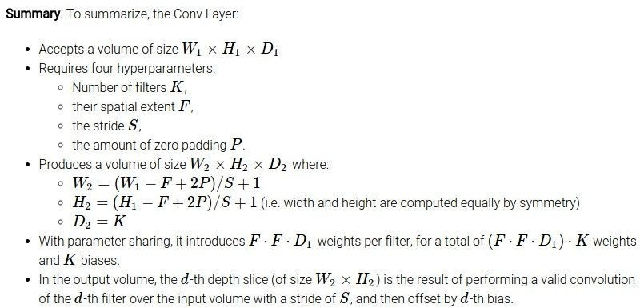

Slide 37
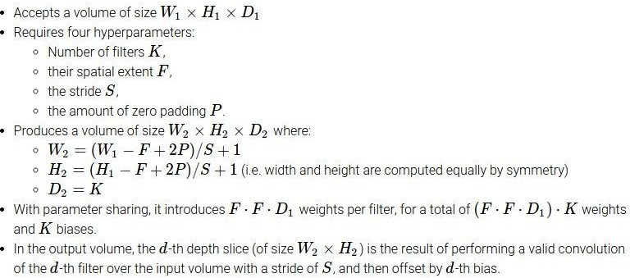
Summary

Slide 38
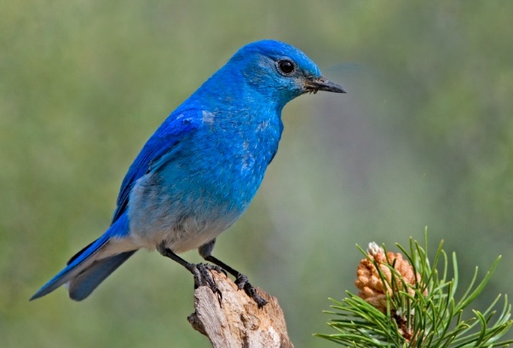
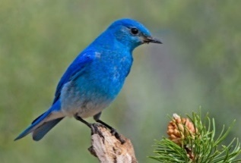
Why Pooling
Subsampling pixels will not change the object
bird
bird
Subsampling
We can subsample the pixels to make image smaller
fewer parameters to characterize the image

Slide 39
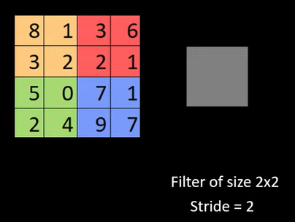

Slide 40
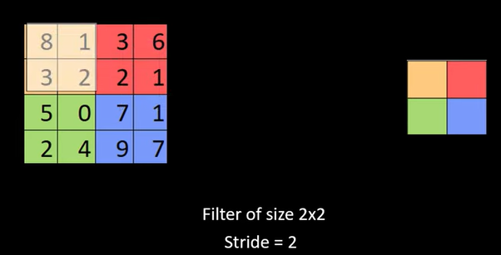

Slide 41
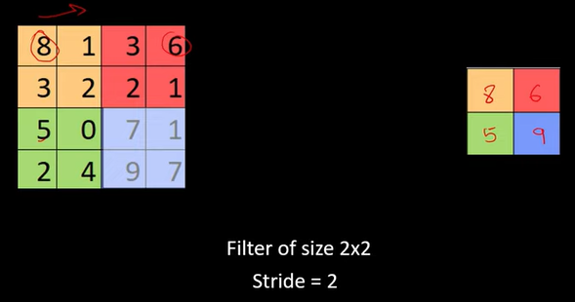

Slide 42
Max Pooling
Single depth slice
1 | 1 | 2 | 4
5 | 6 | 7 | 8
3 | 2 | 1 | 0
1 | 2 | 3 | 4
x
max pool with 2x2 filters and stride 2
6 | 8
3 | 4
y

Slide 43
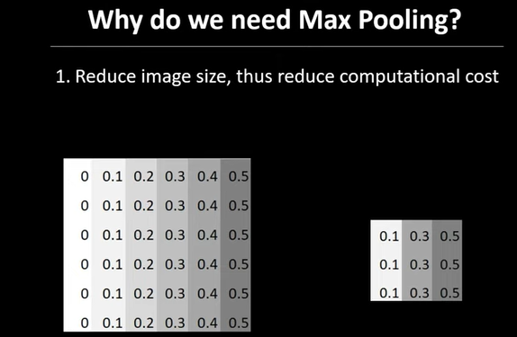

Slide 44
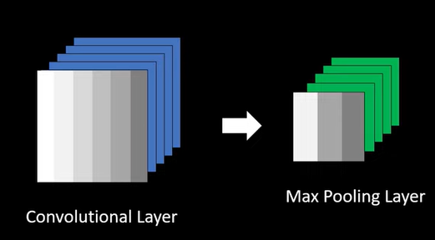

Slide 45
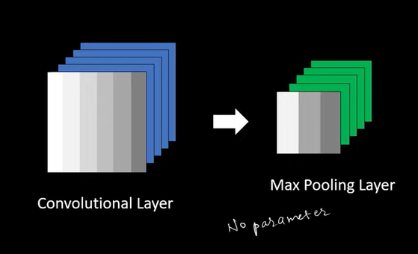

Slide 46
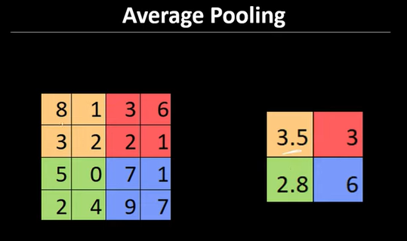

Slide 47
Pooling layers are generally used to reduce the size of the inputs and hence speed up the computation.
The hyperparameters for a pooling layer are:
Filter size
Stride
Max or average pooling

Slide 48
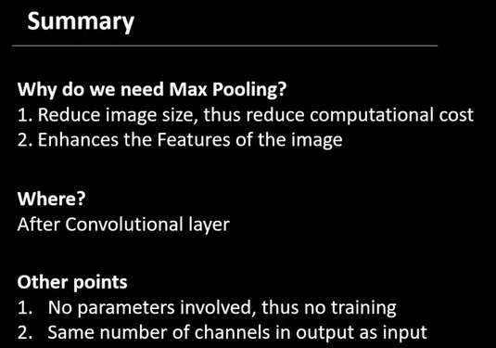

Slide 49
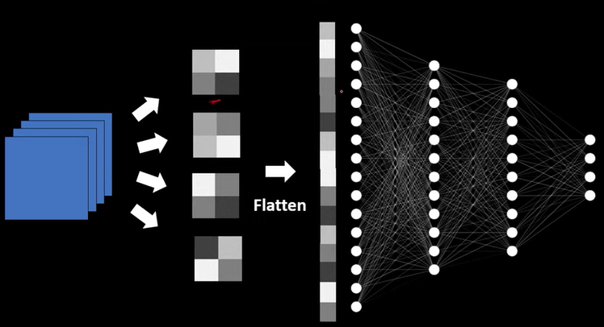

Slide 50
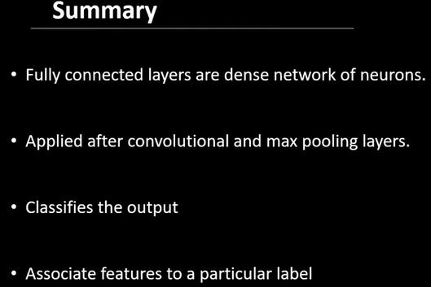

Slide 51
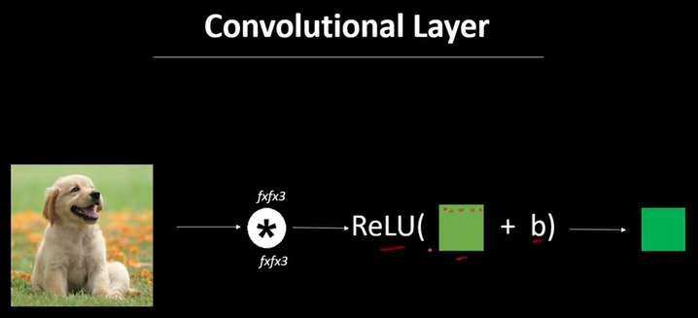

Slide 52
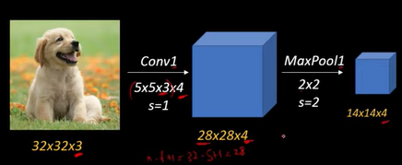

Slide 53
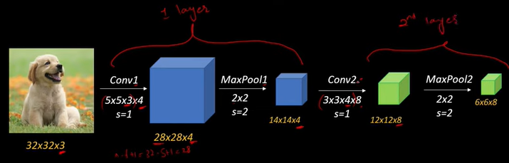

Slide 54
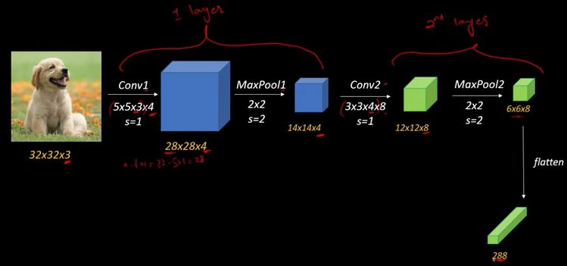

Slide 55
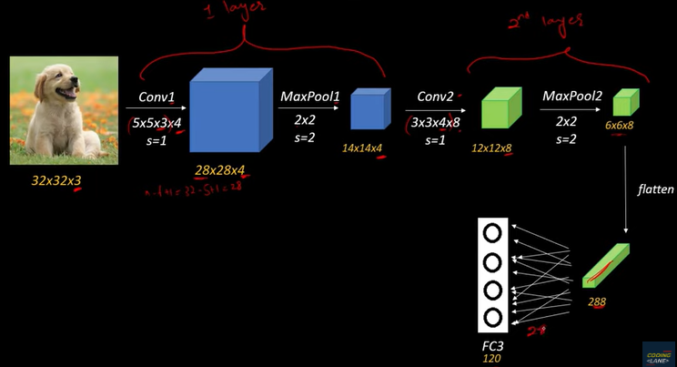

Slide 56
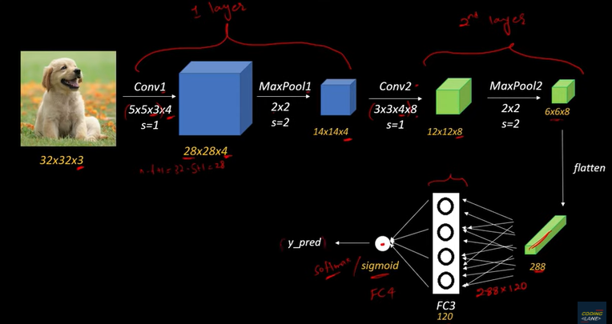

Slide 57
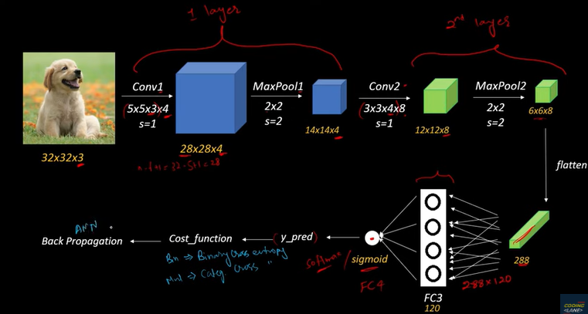

Slide 58
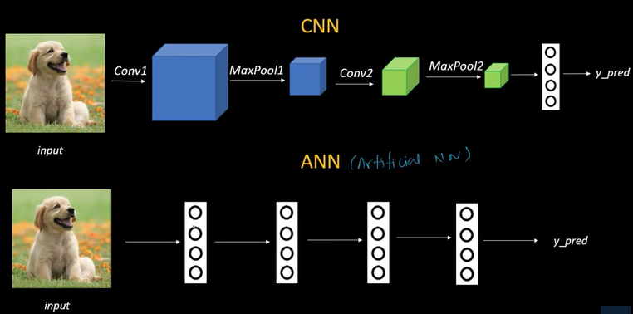

Slide 59
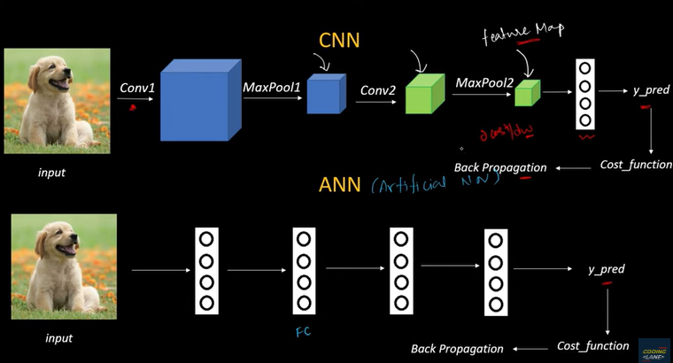

Slide 60
Questions!!

